Slide 1
GRADUATE SCHOOL OF NATURAL AND APPLIED SCIENCES ORIENTATION FALL 2017

Slide 2
Graduate School of Natural and Applied Sciences
We are located on the 1st floor of Engineering Building
Director:
Prof. Şebnem Baydere, Office: A303
Deputy Directors:
Assoc. Prof. Ş. İpek Karaaslan, Office: B609 (Ext: 1689)
Asst. Prof. A. Bahadır Olcay, Office: A703 (Ext: 1461)
Secratary:
Tülay Dalgıç, Office: A304 (Ext: 1491), tdalgic@yeditepe.edu.tr
Tuba Gençer, Office: A302 (Ext: 1492), tuba.gencer@yeditepe.edu.tr
Hakan Metin, Office: A302 (Ext: 1492), hakan.metin@yeditepe.edu.tr
Assistant:
Ece Arpacıoğlu, Office: A302 (Ext: 3134), ece.arpacioglu91@gmail.com

Slide 3
Graduate School of Natural and Applied Sciences
M.Sc Programs
Architecture
Biotechnology
Biomedical Engineering
Civil Engineering
Chemical Engineering
Computer Engineering
Electrical and Electronics Engineering
Mathematics
Material Science and Nanotechnology
Mechanical Engineering
Pilotage
Physics
Systems Engineering
Doctorate Programs
Biotechnology
Chemical Engineering
Computer Engineering
Electrical and Electronics Engineering
Mathematics
Mechanical Engineering
Physics
Systems Engineering
350 Current M.Sc. Students
292 Current Ph.D. Students

Slide 4
RULES and REGULATIONS

Slide 5
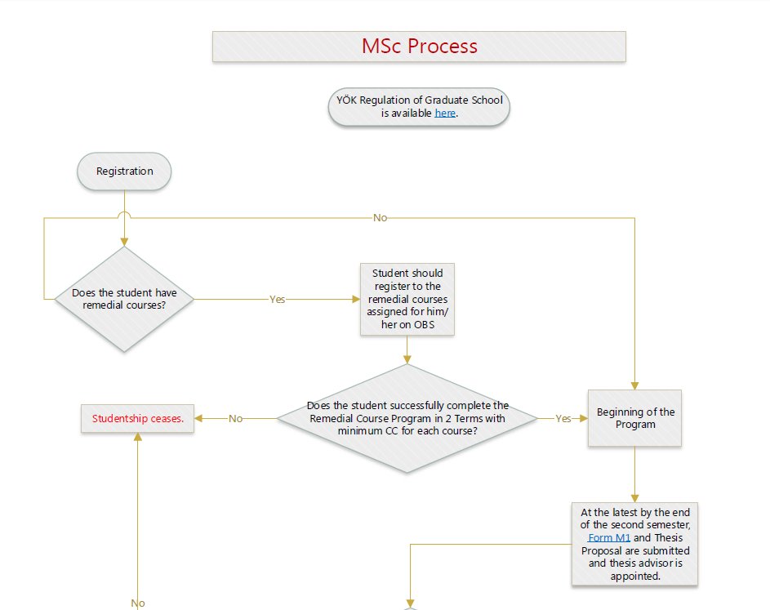

Slide 6
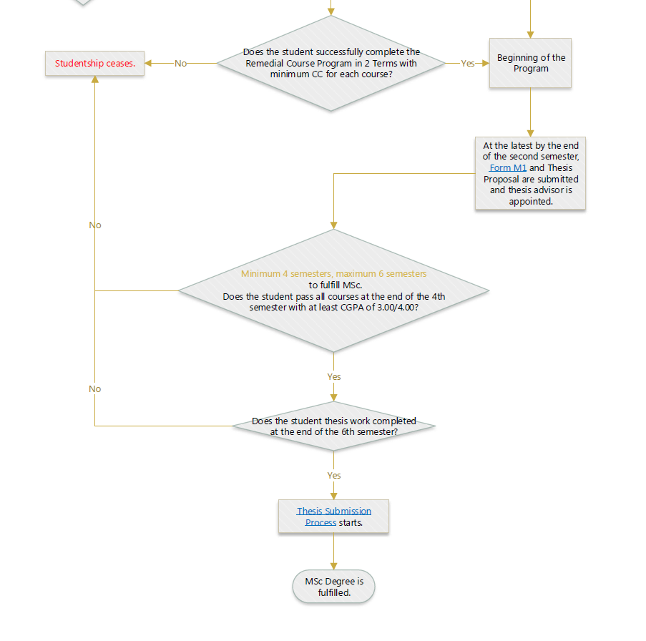

Slide 7
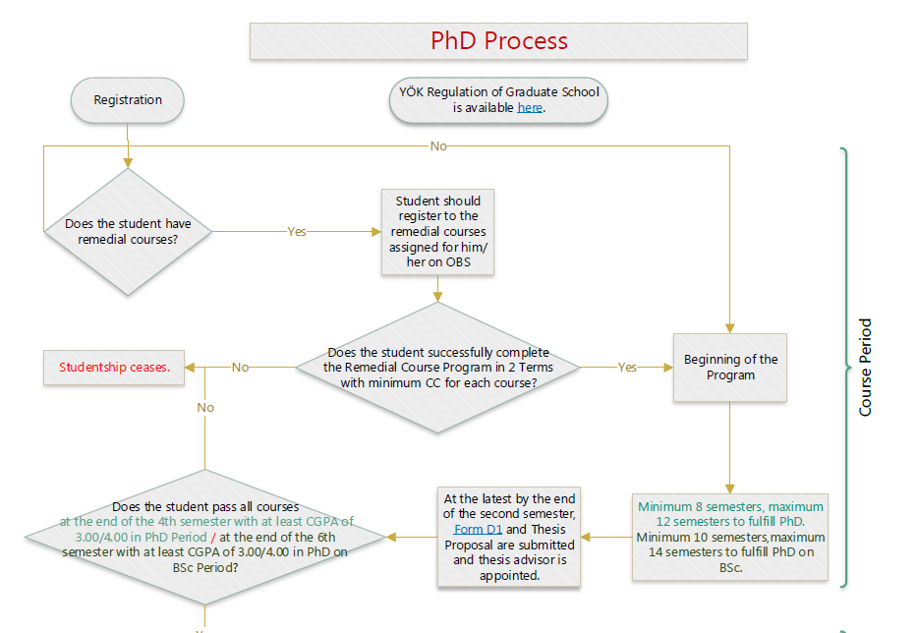

Slide 8
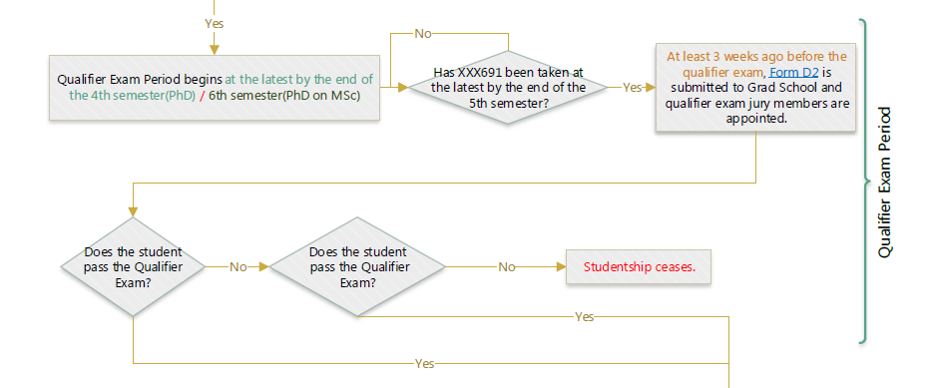

Slide 10
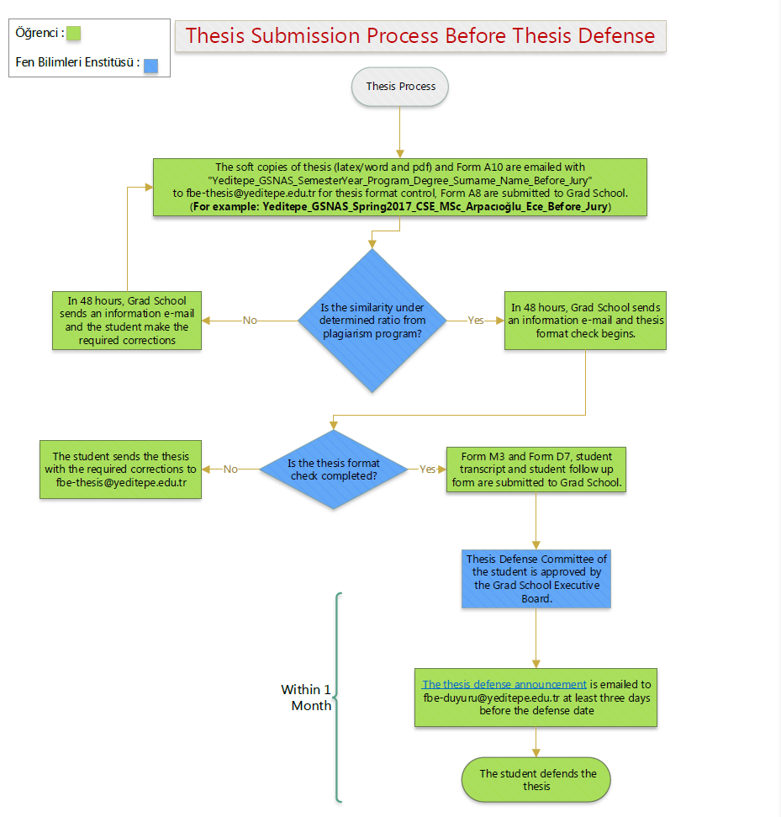

Slide 11
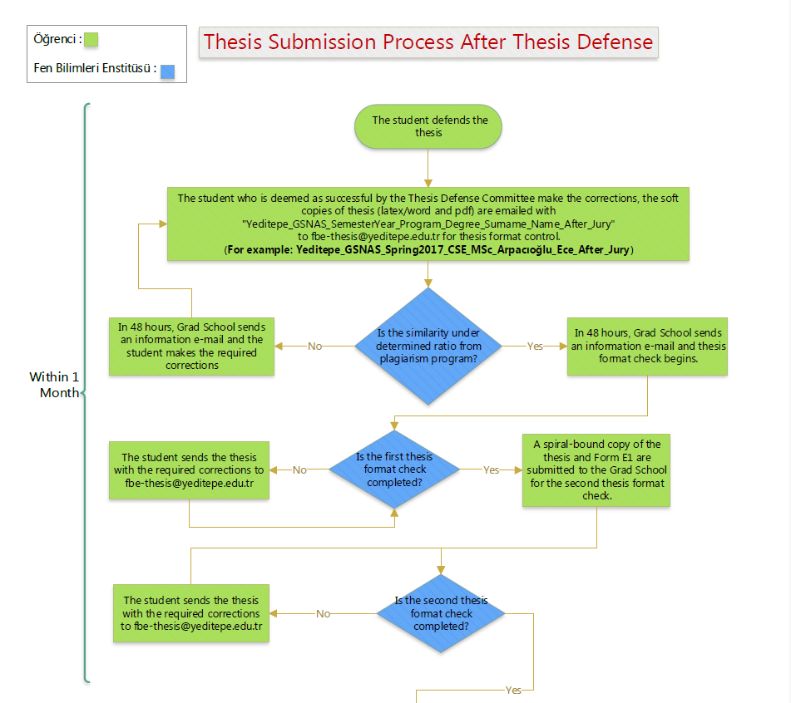

Slide 12
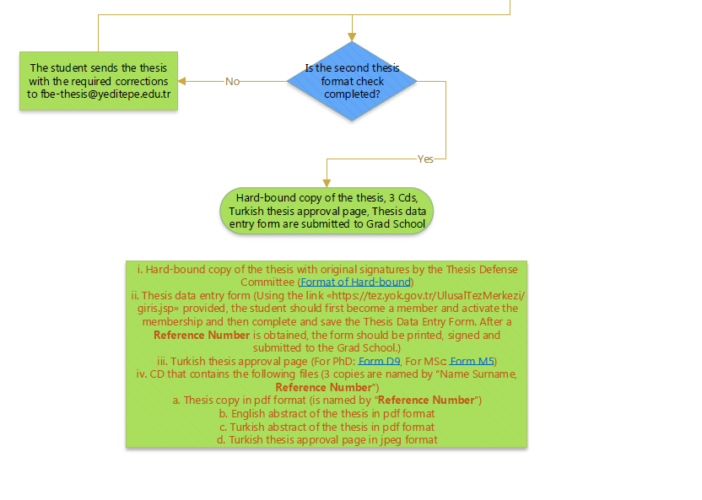

Slide 13
Important Points (Dismissal Procedure)
MSc
Cannot finish course work within 4 terms with CGPA of 3.00
Cannot finish courses and thesis in max. 3 years

Slide 14
Important Points (Dismissal Procedure)
PhD
Cannot finish course work within 4 terms (who holds MSc) and within 6 terms (without MSc degree) with CGPA of 3.00
Cannot pass the qualifying exam for 2 times
Cannot give (be successful) 2 successive or 3 thesis progress reports in total
Cannot finish course and thesis in max. period of time

Slide 15
Graduate School of Natural and Applied Sciences
Important Reminders:
Please check academic calender of the Graduate School for deadlines.
Please make sure that we have your current contact information ( email, telephone and address).
Please register every semester regarding of your stage in the program (qualifying, proposing, thesis etc.)
Those who are in the status of ‘special student’ must bring the missing documents by the end of the first semester.

Slide 16
http://yeditepe.edu.tr/institutes/science-engineering
http://yeditepe.edu.tr/enstituler/fen-bilimleri-enstitusu
http://fbe.yeditepe.edu.tr

